Slide 1

Part I: Bayesian Optimization
Dr Vu Nguyen
vu@robots.ox.ac.uk
University of Oxford

Slide 2
Agenda
Parameter Tuning as Black-Box Function
Part I: Bayesian Optimization
Part II: Recent Advances in Bayesian Optimization
Batch Bayesian Optimization
High dimensional Bayes Opt
Mixed Categorical-Continuous Bayes Opt
Research Directions in Bayesian Optimization

Slide 3
Outline Part 1: Bayesian Optimization
Bayesian Optimization
Gaussian Processes
Acquisition Functions
GP Hyper-parameter Treatments
Applications

Slide 4

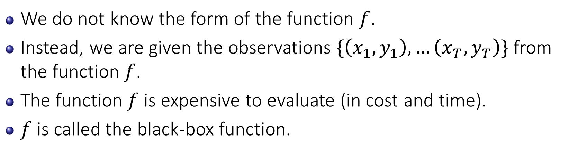
Black-box Function
We do not know the form of the function $f$.
Instead, we are given the observations $\{\left(x_{1},y_{1}\right), …\left(x_{T},y_{T}\right)\}$ from the function $f$.
The function $f$ is expensive to evaluate (in cost and time).
$f$ is called the black-box function.

Slide 5
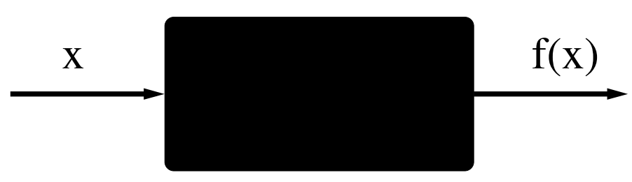
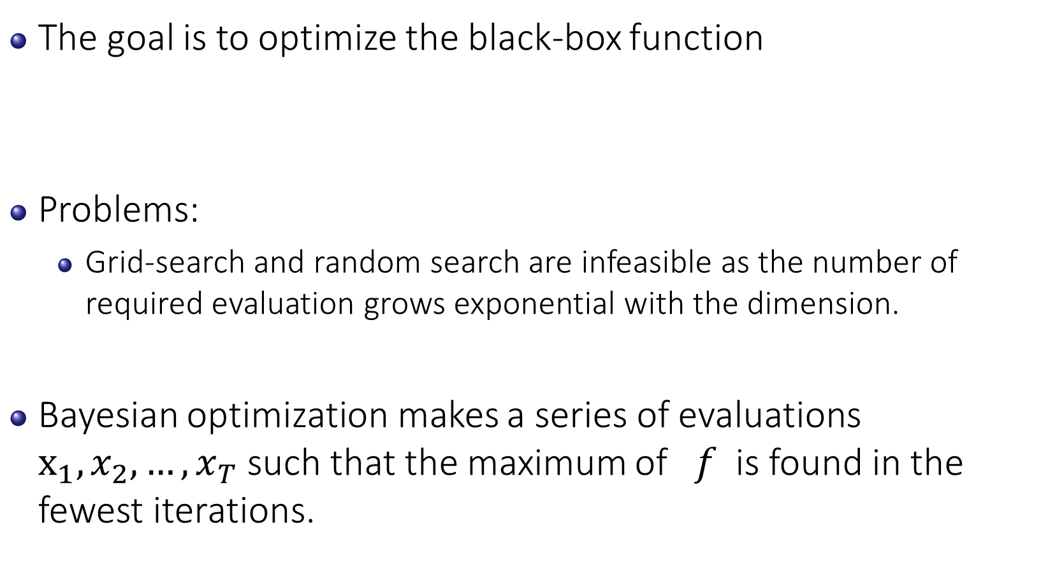
Bayesian Optimization
The goal is to optimize the black-box function
Problems:
Grid-search and random search are infeasible as the number of required evaluation grows exponential with the dimension.
Bayesian optimization makes a series of evaluations $x_{1},x_{2},…,x_{T}$ such that the maximum of $f$ is found in the fewest iterations.
No derivative
Expensive

Slide 6
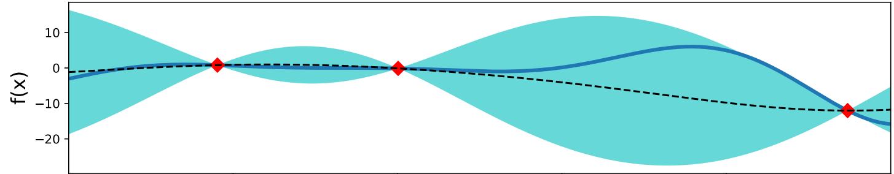
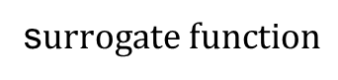
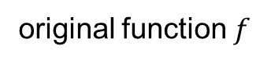
Bayesian Optimization uses Surrogate Models
A surrogate model mimics the behaviour of the true function f as closely as possible.
original function $f$
s$urrogate function$

Slide 7
Bayesian Optimization uses Surrogate Models
A surrogate model mimics the behaviour of the true function f as closely as possible.
A surrogate model is cheap to evaluate.
We will find the maximizer from the acquisition function which is built from surrogate model
instead of the original function
solvable!
unsolvable!

Slide 8
Bayesian Optimization
Choose a prior distribution over the possible spaces of f.
Combine the prior and the likelihood (from the sequential data ) to get the posterior.
Use the posterior to build the acquisition function to select the next evaluation.
Augment the data and repeat steps 2 and 3.

Slide 9
Surrogate Models Requirements
Requirement 1: mimic the behaviour of the true function f.
We can use non-linear regression models.
Requirement 2: uncertainty for exploration
We can use any non-linear models which can provide the uncertainty.

Slide 10
Surrogate Models for Bayesian Optimization
Gaussian Process
Random Forest (F. Hutter et al 2011)
Support Vector Regression
Student-t Process (A. Shah et al NIPS 2013 Workshop)
Deep Neural Network (J. Snoek et al ICML 2015)
Bayesian Neural Network (JT. Springenberg at al NIPS 2016)

Slide 11
Outline Part 1: Bayesian Optimization
Bayesian Optimization
Gaussian Processes
Acquisition Functions
GP Hyper-parameter Treatments
Applications

Slide 12
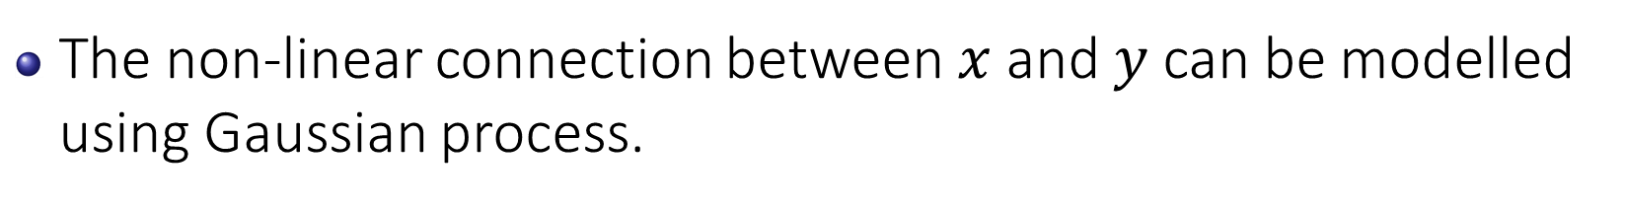
Motivation for Using GP as a Surrogate Model
The non-linear connection between $x$ and $y$ can be modelled using Gaussian process.

Slide 13
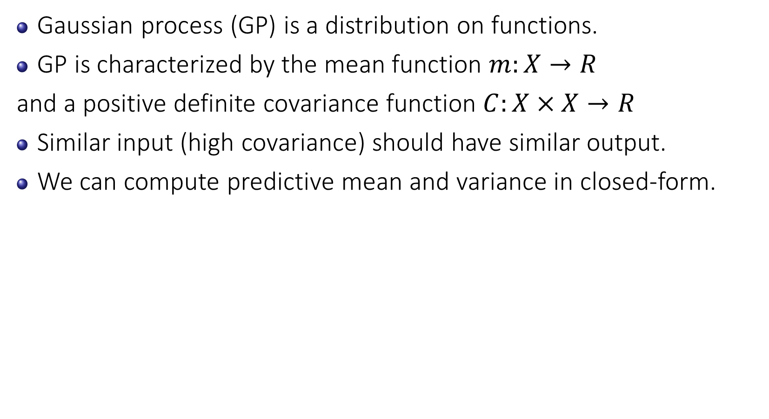
Gaussian Process
Gaussian process (GP) is a distribution on functions.
GP is characterized by the mean function $m:X→R$
and a positive definite covariance function $C:X×X→R$
Similar input (high covariance) should have similar output.
We can compute predictive mean and variance in closed-form.

Slide 14
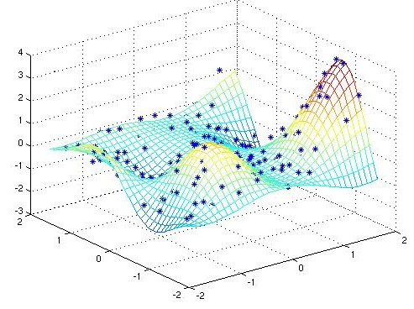
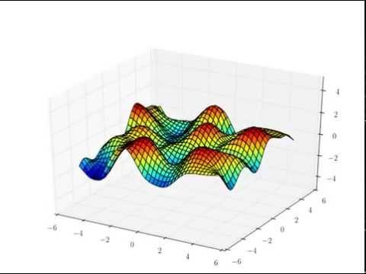
Examples of Gaussian Process
Fitting 2D using Gaussian Process

Slide 15
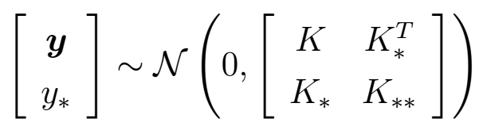
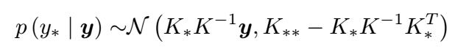
Gaussian Process
The joint distribution
The predictive probability
linear algebra
predictive mean
predictive variance

Slide 16
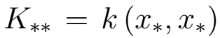
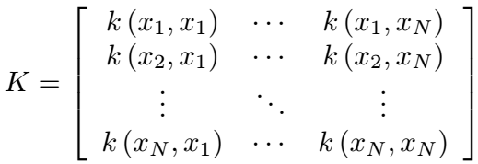
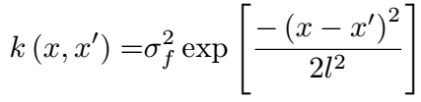
Gaussian Process
The predictive probability
The covariance matrices are defined as follows
predictive mean
predictive variance

Slide 17
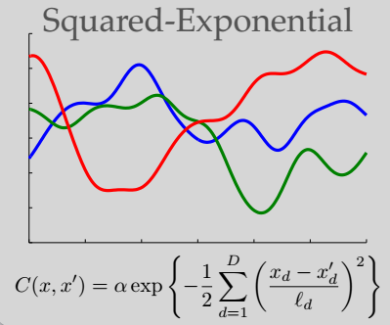
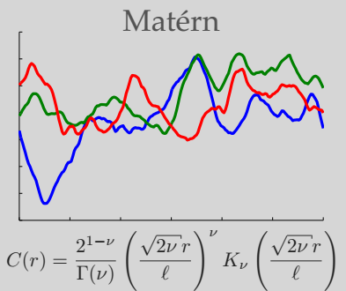
Examples of GP Covariance functions
Two commonly used covariance functions in Bayesian Optimization

Slide 18
Outline Part 1: Bayesian Optimization
Bayesian Optimization
Gaussian Processes
Acquisition Functions
Illustration
Upper Confidence Bound (UCB) and Expected Improvement (EI)
Thompson Sampling (TS) and Predictive Entropy Search (PES)
Computational Time
Optimization toolbox for acquisition function.
GP Hyper-parameter Treatments
Applications

Slide 19
Acquisition Functions – Decision Functions
After we get a good estimation of the surrogate function via a Gaussian Process model.
Acquisition function suggests the next point to evaluate.
a decision strategy balancing the exploration-exploitation.
Exploration: seek places with high variance (uncertainty).
Exploitation: seek places in the locality of where you are already doing well at.

Slide 20
Common Acquisition Functions
Expected Improvement [Mokus, 1972]
Probability of Improvement [Krushner, 1997]
GP Upper Confidence Bound [Srinivas, 2010]
Predictive Entropy Search [Hernández-Lobato, 2014]
….
Balancing the exploration-exploitation in different ways.

Slide 21
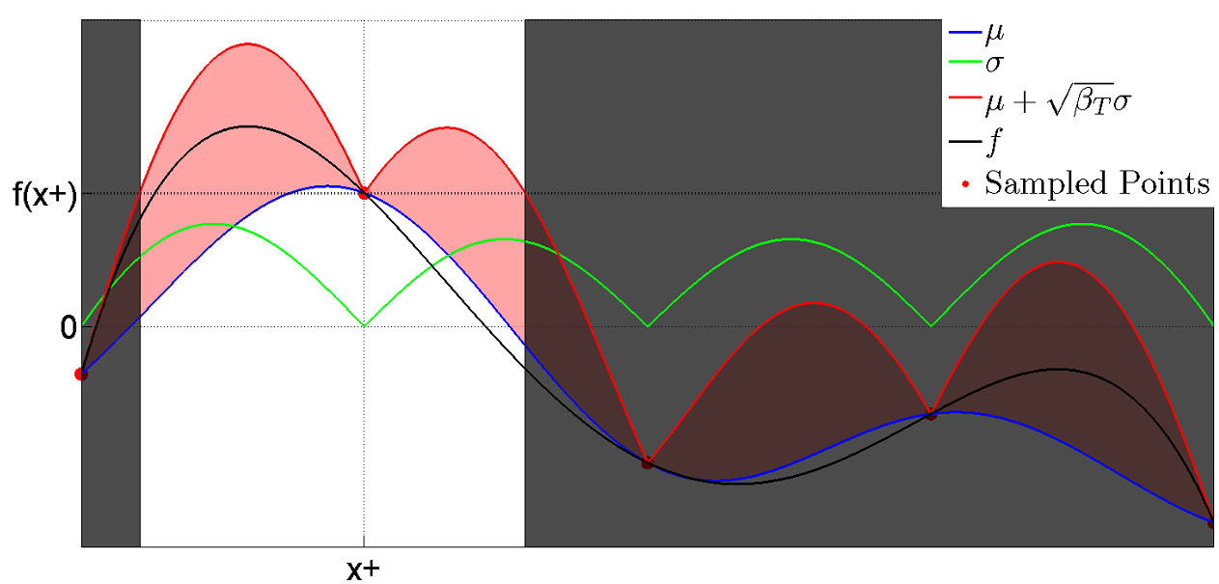
Example of Acquisition Functions
Red line (acquisition function) vs black line (original function)
Notes:
The prediction is not just an estimate for that point, but also has uncertainty information -- it is a one-dimensional Gaussian distribution (which is the marginal distribution at that point).

Slide 22
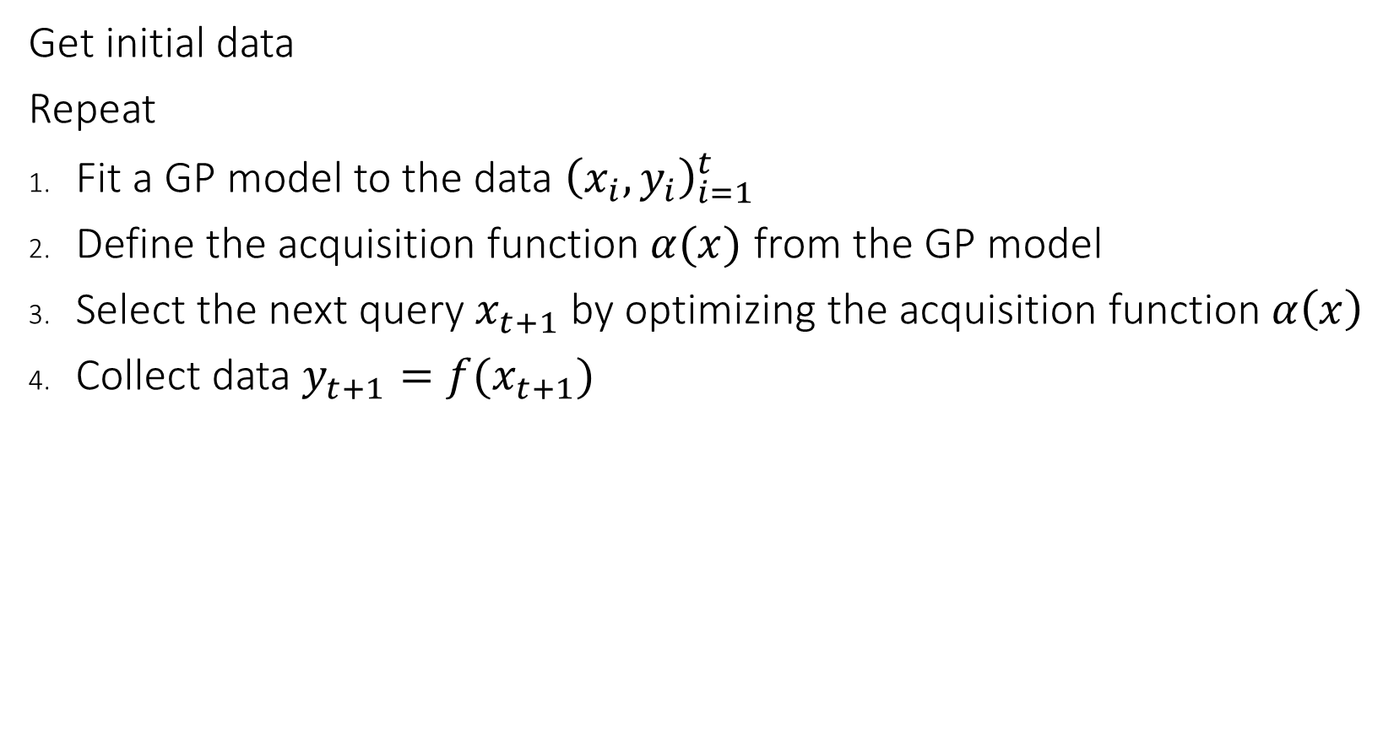
Bayesian Optimization Algorithm
Get initial data
Repeat
Fit a GP model to the data ${\left(x_{i},y_{i}\right)}_{i=1}^{t}$
Define the acquisition function $α(x)$ from the GP model
Select the next query $x_{t+1}$ by optimizing the acquisition function $α\left(x\right)$
Collect data $y_{t+1}=f(x_{t+1})$

Slide 23
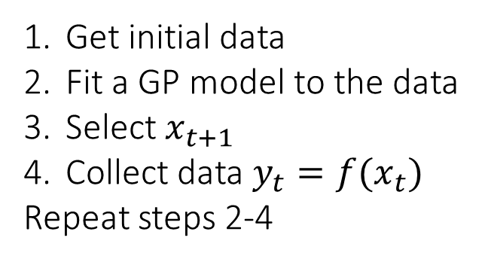
Illustration of Bayesian Optimization
Get initial data
Fit a GP model to the data
Select $x_{t+1}$
Collect data $y_{t}=f(x_{t})$
Repeat steps 2-4
Intuitively, BO selects a point which has high mean and high variance.

Slide 24
Illustration of Bayesian Optimization
High variance
Become low variance
The uncertainty at the selected points will be significantly reduced. The choice encodes the exploration.

Slide 25
Illustration of Bayesian Optimization
High variance
Become low variance
The uncertainty at the selected points will be significantly reduced. The choice encodes the exploration.

Slide 26
Different of Acquisition Functions (3 points)

Slide 27
Different of Acquisition Functions (4 observations)

Slide 28
Different of Acquisition Functions (5 points)

Slide 29
Different of Acquisition Functions (7 points)

Slide 30
Different of Acquisition Functions (10 points)

Slide 31
Outline Part 1: Bayesian Optimization
Bayesian Optimization
Gaussian Processes
Acquisition Functions
Illustration
Upper Confidence Bound (UCB) and Expected Improvement (EI)
Thompson Sampling (TS) and Predictive Entropy Search (PES)
Computational Time
Optimization toolbox for acquisition function.
GP Hyper-parameter Treatments
Applications

Slide 32
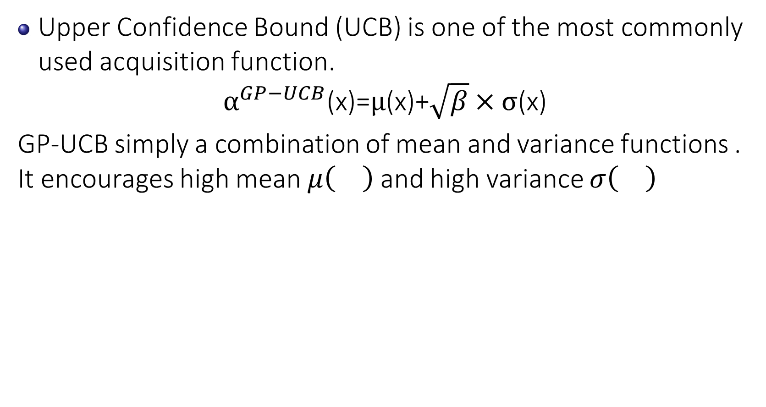
Upper Confidence Bound (UCB)
Upper Confidence Bound (UCB) is one of the most commonly used acquisition function.
$$α^{GP−UCB}\text{(}\text{x}\text{)=}μ\text{(}\text{x}\text{)+}\sqrt{β}×σ\text{(}\text{x}\text{)}$$
GP-UCB simply a combination of mean and variance functions . It encourages high mean $μ\left(\right)$ and high variance $σ\left(\right)$

Slide 33
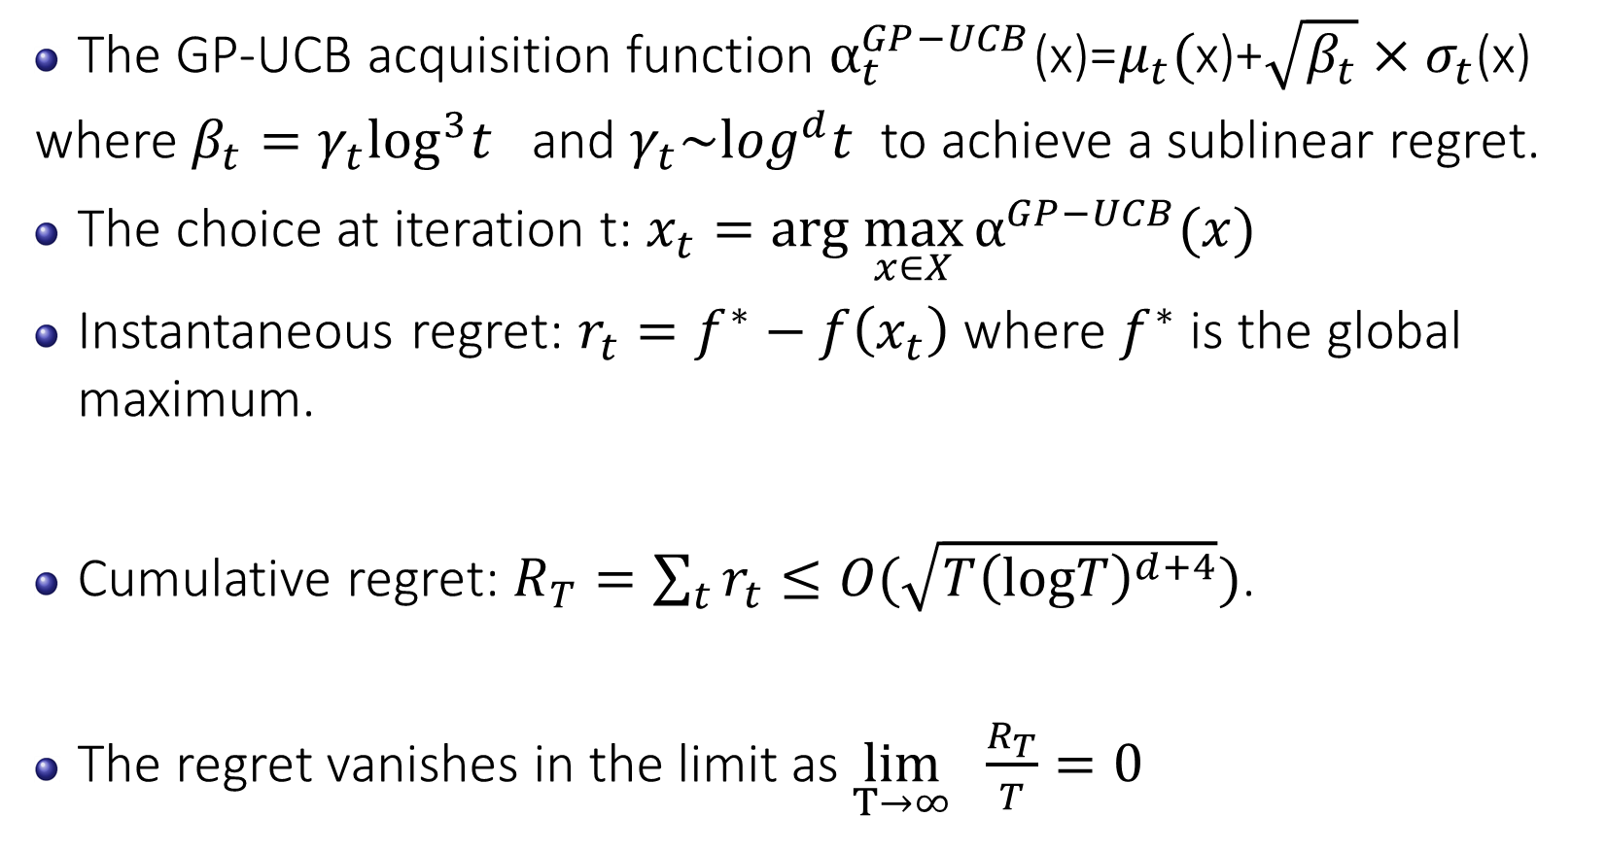
Convergence Analysis for GP-UCB
The GP-UCB acquisition function $α_{t}^{GP−UCB}\text{(}\text{x}\text{)=}μ_{t}\text{(}\text{x}\text{)+}\sqrt{β_{t}}×σ_{t}\text{(}\text{x}\text{) }$
where $β_{t}=γ_{t}\log^{3}t$ and $γ_{t}\sim \log^{d}t$ to achieve a sublinear regret.
The choice at iteration t: $x_{t}=arg \max_{x∈X}{α^{GP−UCB}(x)}$
Instantaneous regret: $r_{t}=f^{∗}−f\left(x_{t}\right)$ where $f^{∗}$ is the global maximum.
Cumulative regret: $R_{T}=\sum_{t}{r_{t}}≤O(\sqrt{T{\left(logT\right)}^{d+4}})$.
The regret vanishes in the limit as $\lim_{T→∞} \frac{R_{T}}{T}=0$

Slide 34
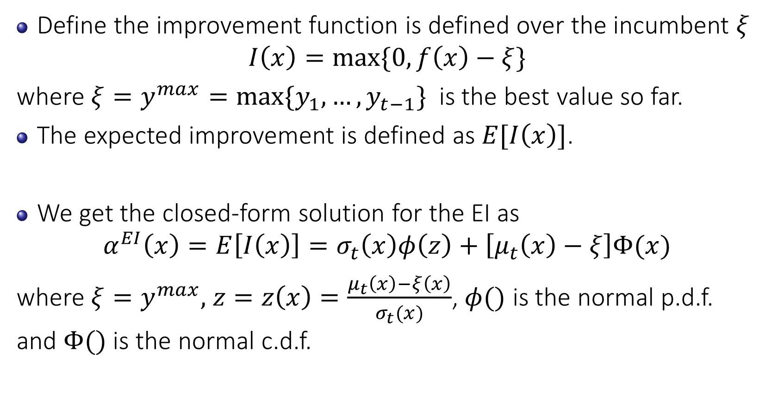
Expected Improvement (EI)
Define the improvement function is defined over the incumbent $ξ$
$$I\left(x\right)=max⁡\{0,f\left(x\right)−ξ\}$$
where $ξ=y^{max}=max\{y_{1},…,y_{t−1}\}$ is the best value so far.
The expected improvement is defined as $E[I\left(x\right)]$.
We get the closed-form solution for the EI as
$$α^{EI}\left(x\right)=E\left[I\left(x\right)\right]=σ_{t}\left(x\right)φ\left(z\right)+\left[μ_{t}\left(x\right)−ξ\right]Φ(x)$$
where $ξ=y^{max},$ $z=z\left(x\right)=\frac{μ_{t}\left(x\right)−ξ\left(x\right)}{σ_{t}(x)}$, $φ()$ is the normal p.d.f. and $Φ()$ is the normal c.d.f.

Slide 35
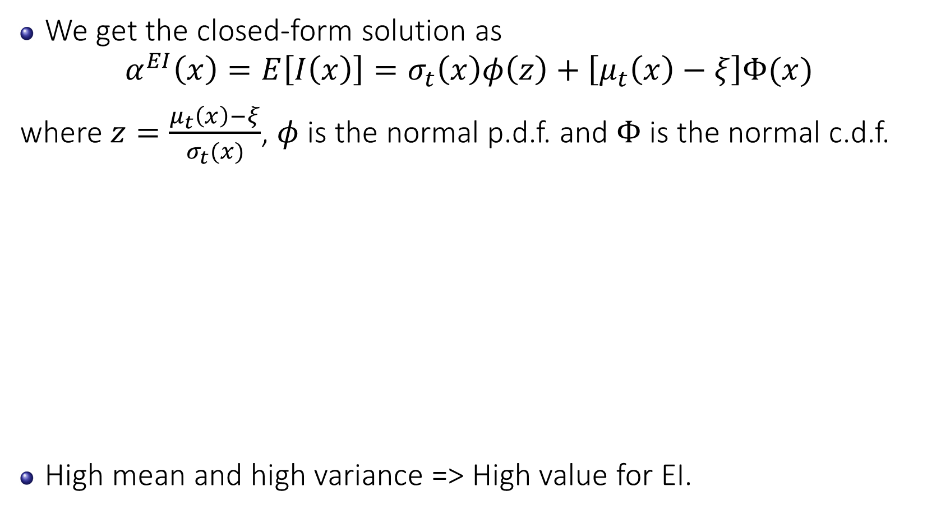
Expected Improvement
We get the closed-form solution as
$$α^{EI}\left(x\right)=E\left[I\left(x\right)\right]=σ_{t}\left(x\right)φ\left(z\right)+\left[μ_{t}\left(x\right)−ξ\right]Φ(x)$$
where $z=\frac{μ_{t}\left(x\right)−ξ}{σ_{t}(x)}$, $φ$ is the normal p.d.f. and $Φ$ is the normal c.d.f.
High mean and high variance => High value for EI.

Slide 36
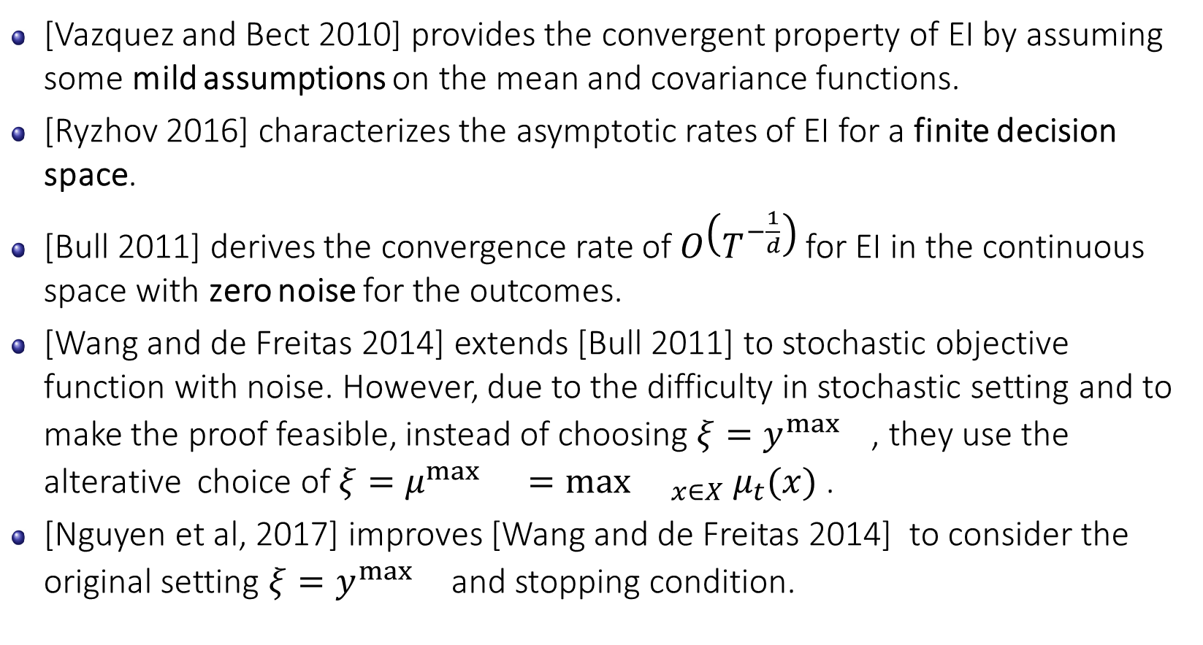
Convergence Analysis for Expected Improvement
[Vazquez and Bect 2010] provides the convergent property of EI by assuming some mild assumptions on the mean and covariance functions.
[Ryzhov 2016] characterizes the asymptotic rates of EI for a finite decision space.
[Bull 2011] derives the convergence rate of $O\left(T^{−\frac{1}{d}}\right)$ for EI in the continuous space with zero noise for the outcomes.
[Wang and de Freitas 2014] extends [Bull 2011] to stochastic objective function with noise. However, due to the difficulty in stochastic setting and to make the proof feasible, instead of choosing $ξ=y^{\max{}}$, they use the alterative choice of $ξ=μ^{\max{} }=\max{{}_{x∈X}{ μ}_{t}(x)}$ .
[Nguyen et al, 2017] improves [Wang and de Freitas 2014] to consider the original setting $ξ=y^{\max{}}$ and stopping condition.

Slide 37
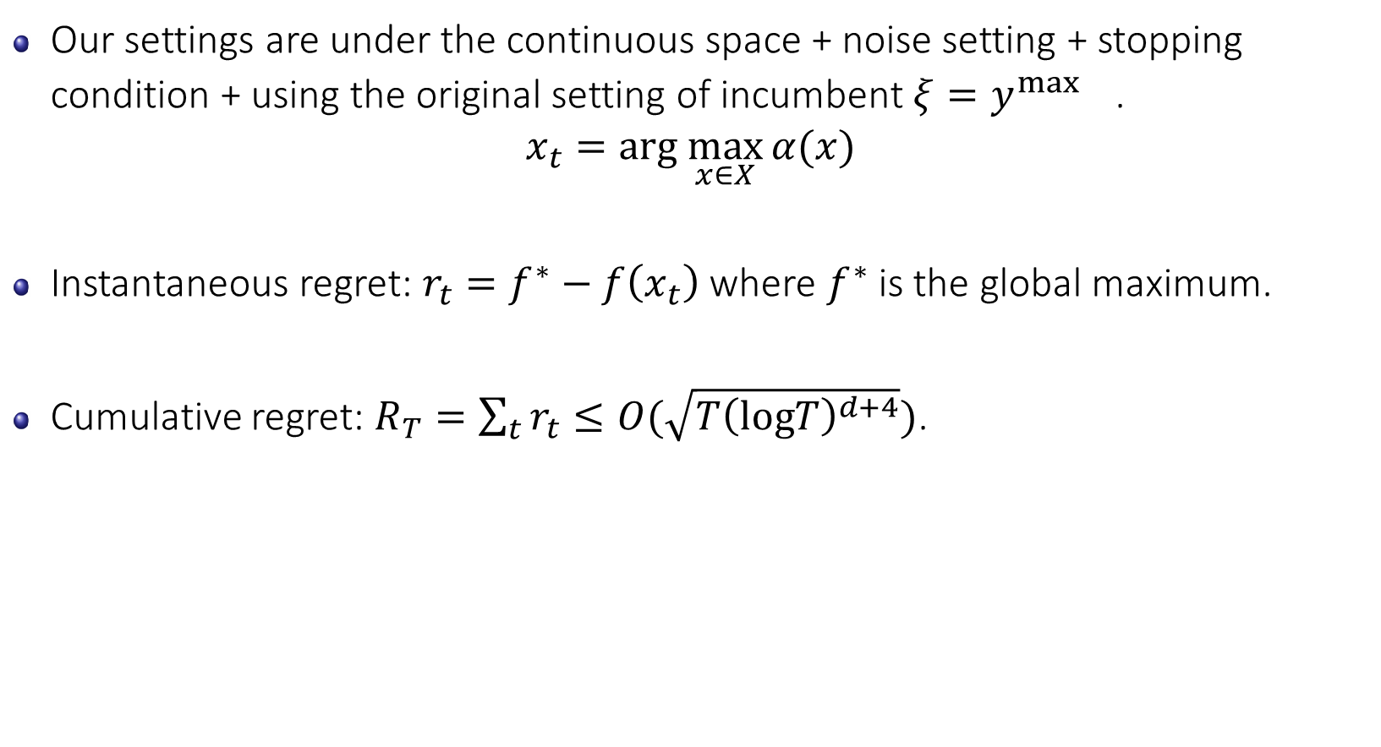
Convergence Analysis for Expected Improvement
Our settings are under the continuous space + noise setting + stopping condition + using the original setting of incumbent $ξ=y^{\max{}}$.
$$x_{t}=arg \max_{x∈X}{α(x)}$$
Instantaneous regret: $r_{t}=f^{∗}−f\left(x_{t}\right)$ where $f^{∗}$ is the global maximum.
Cumulative regret: $R_{T}=\sum_{t}{r_{t}}≤O(\sqrt{T{\left(logT\right)}^{d+4}})$.
V. Nguyen, S. Rana, C. Li, S. Gupta, S. Venkatesh, S. Regret for Expected Improvement over the Best-Observed Value and Stopping Condition. In ACML 2017

Slide 38
Illustration of Stopping Criteria for EI
After running for a certain iterations, the EI acquisition function value seems converged and is closed to zero.

Slide 39
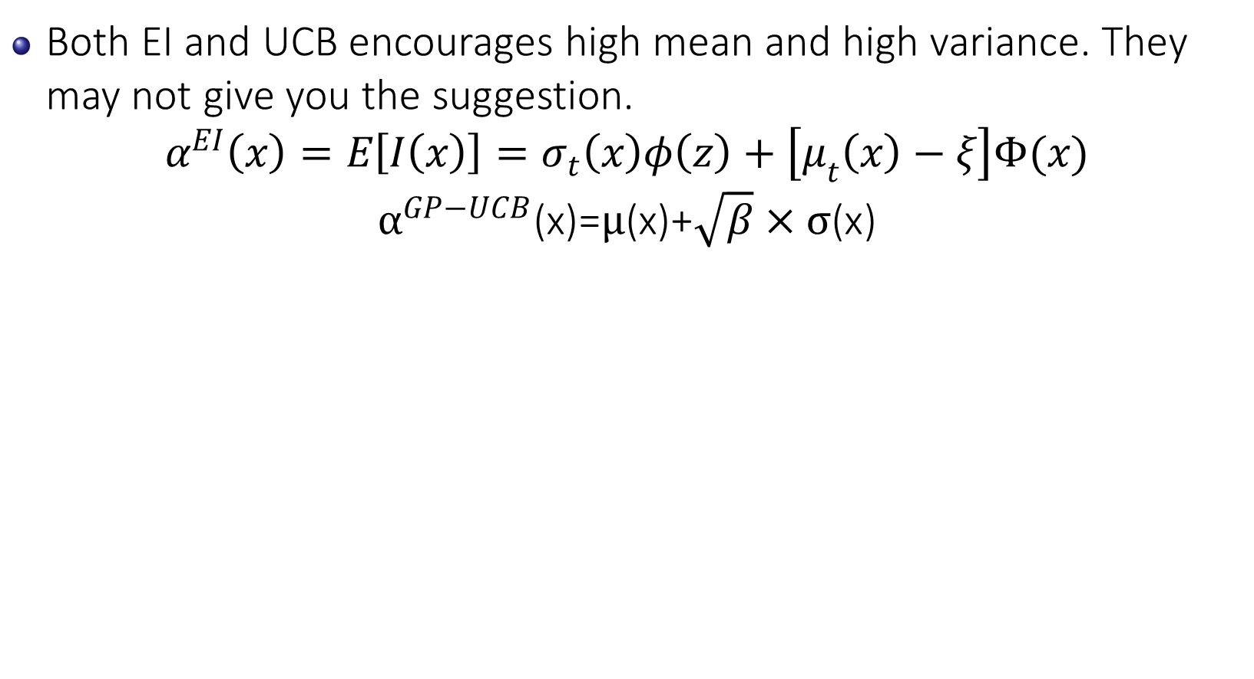
Remark on Expected Improvement vs UCB
Both EI and UCB encourages high mean and high variance. They may not give you the suggestion.
$$α^{EI}\left(x\right)=E\left[I\left(x\right)\right]=σ_{t}\left(x\right)φ\left(z\right)+\left[μ_{t}\left(x\right)−ξ\right]Φ(x)$$
$$α^{GP−UCB}\text{(}\text{x}\text{)=}μ\text{(}\text{x}\text{)+}\sqrt{β}×σ\text{(}\text{x}\text{)}$$

Slide 40
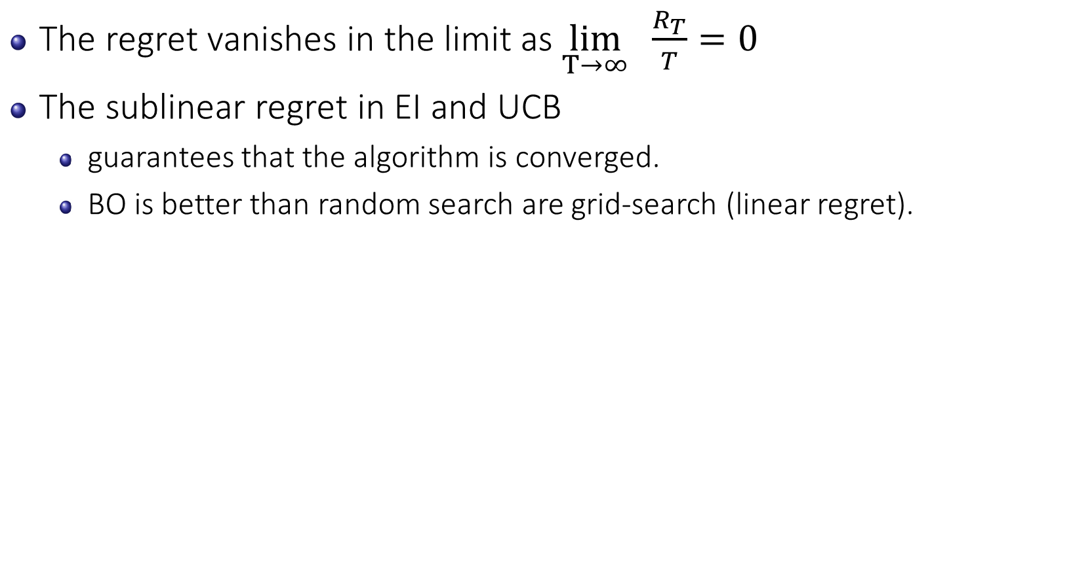
Remark on Expected Improvement vs UCB
The regret vanishes in the limit as $\lim_{T→∞} \frac{R_{T}}{T}=0$
The sublinear regret in EI and UCB
guarantees that the algorithm is converged.
BO is better than random search are grid-search (linear regret).

Slide 41
Outline Part 1: Bayesian Optimization
Bayesian Optimization
Gaussian Processes
Acquisition Functions
Illustration
Upper Confidence Bound (UCB) and Expected Improvement (EI)
Thompson Sampling (TS) and Predictive Entropy Search (PES)
Computational Time
Optimization toolbox for acquisition function.
GP Hyper-parameter Treatments
Applications

Slide 42
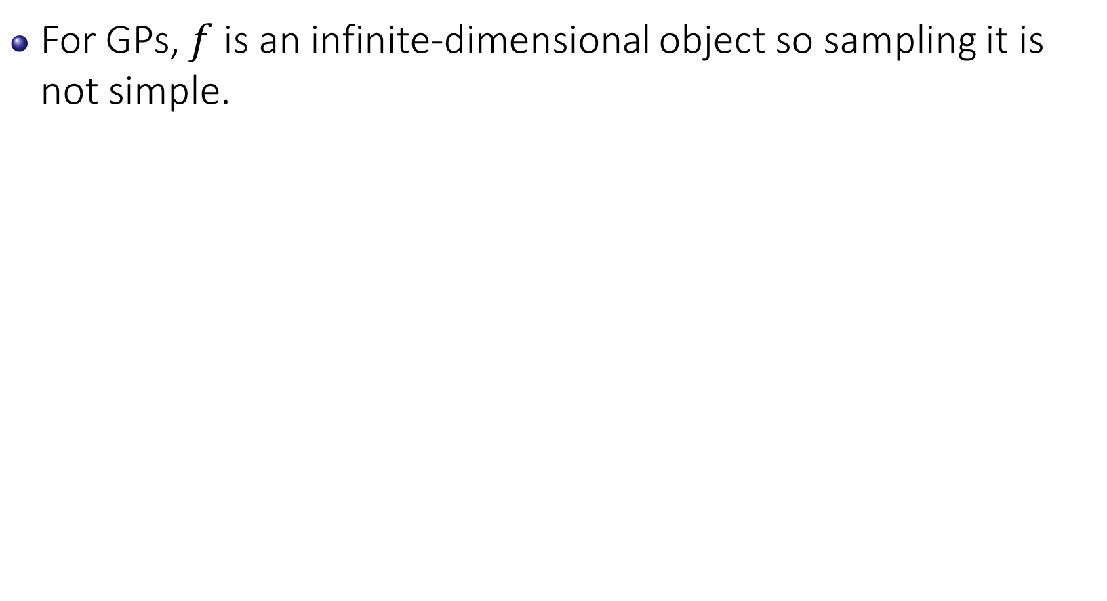
Thompson Sampling for GP
For GPs, $f$ is an infinite-dimensional object so sampling it is not simple.

Slide 43
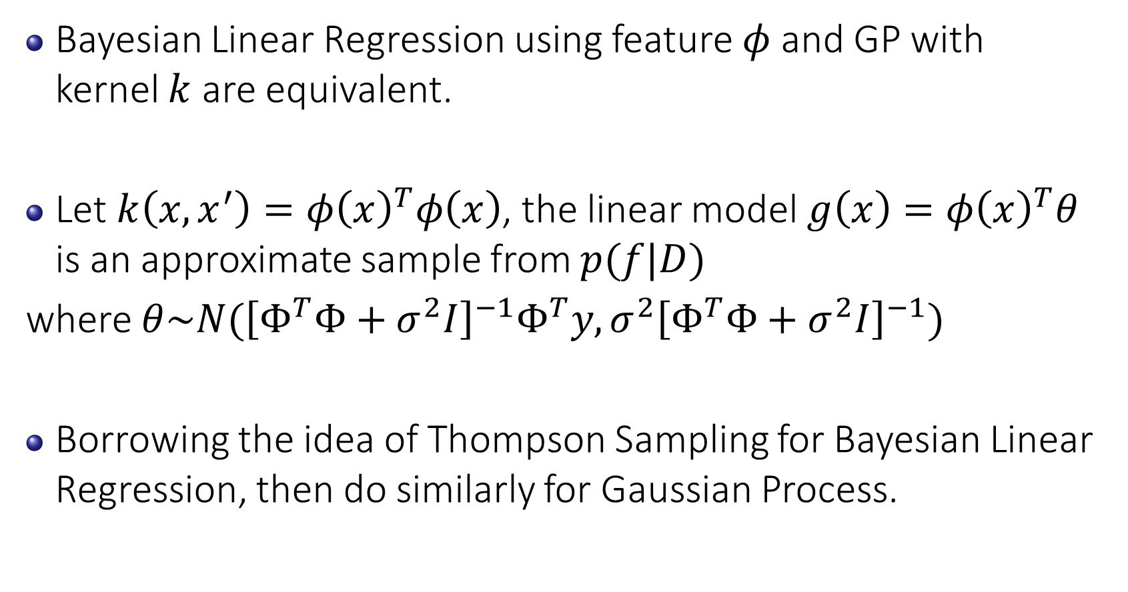
Connection of Gaussian Process to Linear Model
Bayesian Linear Regression using feature $φ$ and GP with kernel $k$ are equivalent.
Let $k\left(x,x^{′}\right)=φ{\left(x\right)}^{T}φ\left(x\right)$, the linear model $g\left(x\right)=φ{\left(x\right)}^{T}θ$ is an approximate sample from $p(f|D)$
where $θ\sim N({\left[Φ^{T}Φ+σ^{2}I\right]}^{−1}Φ^{T}y,σ^{2}{\left[Φ^{T}Φ+σ^{2}I\right]}^{−1})$
Borrowing the idea of Thompson Sampling for Bayesian Linear Regression, then do similarly for Gaussian Process.

Slide 44
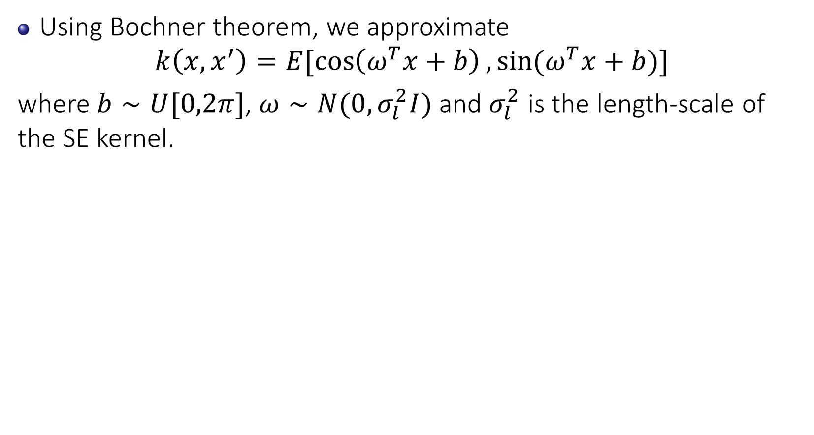
Approximate kernel by Random Fourier feature
Using Bochner theorem, we approximate
$$k\left(x,x^{′}\right)=E[\cos\left(ω^{T}x+b\right),sin⁡(ω^{T}x+b)]$$
where $b∼U[0,2π]$, $ω∼N(0,σ_{l}^{2}I)$ and $σ_{l}^{2}$ is the length-scale of the SE kernel.

Slide 45
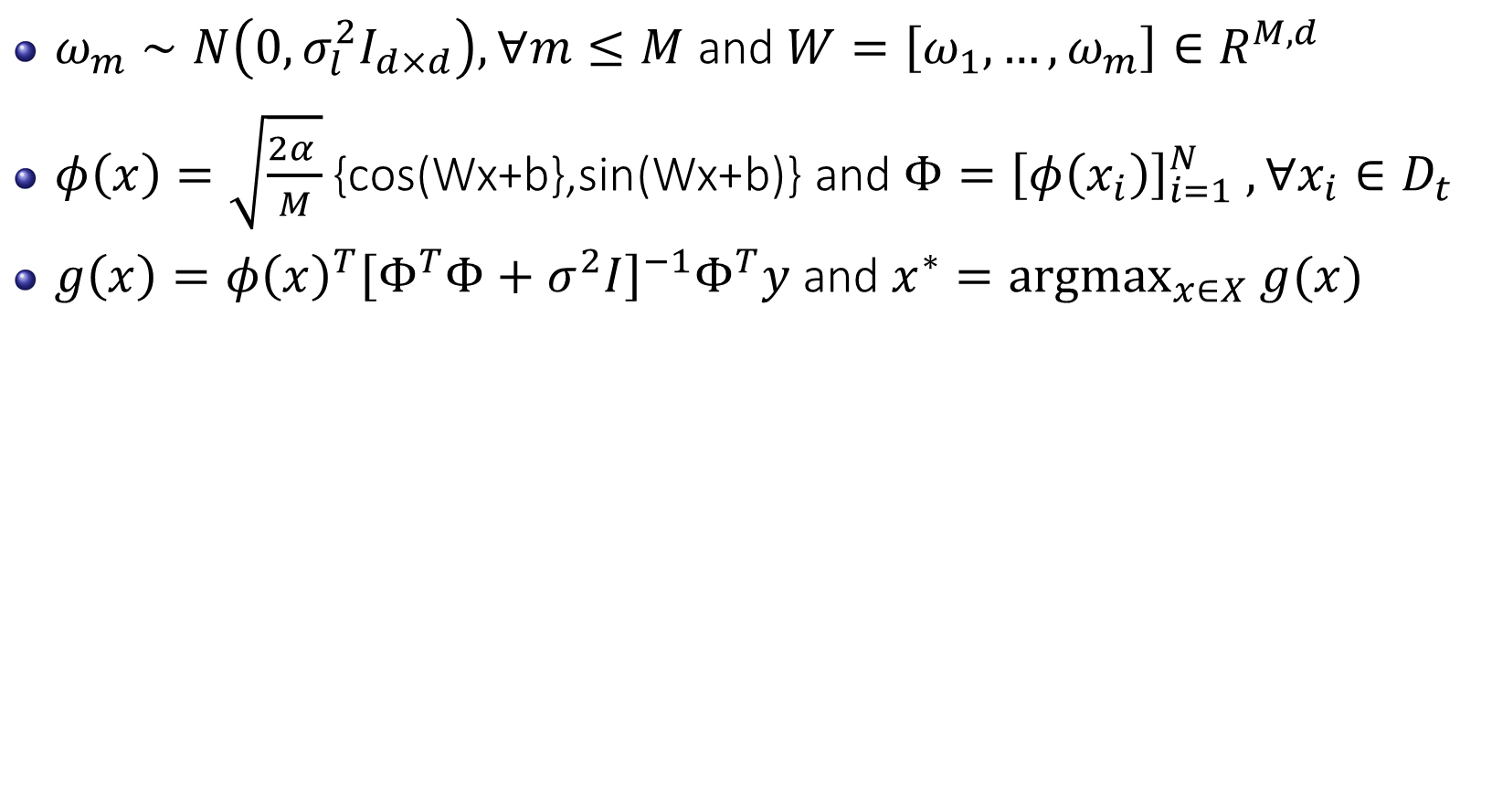
Thompson Sampling from a Gaussian process
$ω_{m}∼N\left(0,σ_{l}^{2}I_{d×d}\right),∀m≤M$ and $W=\left[ω_{1},…,ω_{m}\right]∈R^{M,d}$
$φ\left(x\right)=\sqrt{\frac{2α }{M}}\text{\{}\text{cos}\text{(}\text{Wx}\text{+}\text{b}\text{\},}\text{sin}\text{(}\text{Wx}\text{+}\text{b}\text{)\}}$ and $Φ={\left[φ\left(x_{i}\right)\right]}_{i=1}^{N} ,∀x_{i}∈D_{t}$
$g\left(x\right)=φ{\left(x\right)}^{T}{\left[Φ^{T}Φ+σ^{2}I\right]}^{−1}Φ^{T}y$ and $x^{∗}={argmax}_{x∈X} g(x)$

Slide 46
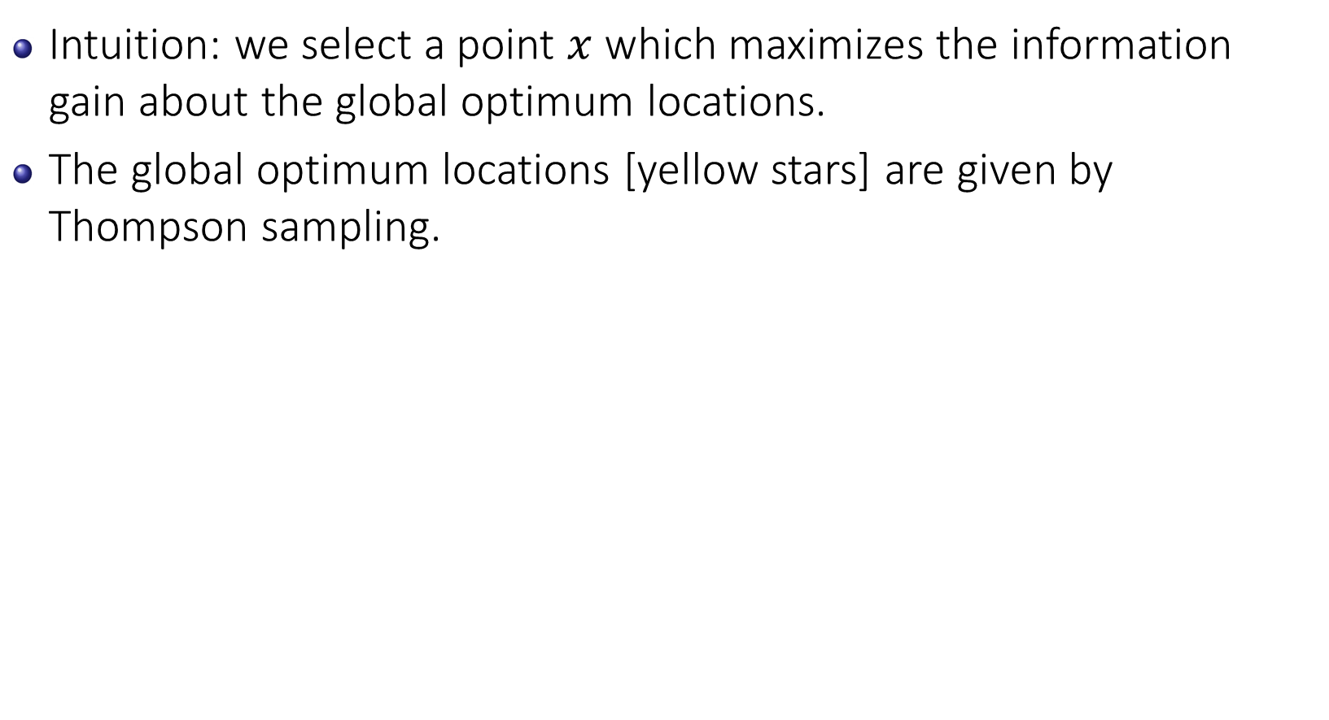
Predictive Entropy Search
Intuition: we select a point $x$ which maximizes the information gain about the global optimum locations.
The global optimum locations [yellow stars] are given by Thompson sampling.

Slide 47
Predictive Entropy Search
Gaussian likelihood
1) Thompson sampling
2) Expectation propagation
Gaussian likelihood
Posterior distribution
Conditioning on x*
intractable !

Slide 48
Predictive Entropy Search
Posterior distribution
Conditioning on x*
intractable !
Approximate using following simplified constraints:
x* is a local maximum
f(x*) is larger than past observations f(x_t)
f(x*)>f(x), for the x considered.

Slide 49
Computational Time Across Acquisition Function
PES is much slower than the other acquisition function EI, UCB, PI.
However, we note that the time for evaluating the black-box function is much more expensive than the time used for optimizing BO.

Slide 50
Toolbox for Maximizing The Acquisition Function
They are available in different programming languages: Matlab, Python, C++…
DIRECT
NLOPT
COBYLA
L-BFGS-B
….

Slide 51
Outline Part 1: Bayesian Optimization
Bayesian Optimization
Gaussian Processes
Acquisition Functions
Illustration
Upper Confidence Bound (UCB) and Expected Improvement (EI)
Thompson Sampling (TS) and Predictive Entropy Search (PES)
Computational Time
Optimization toolbox for acquisition function.
GP Hyper-parameter Treatments
Applications

Slide 52
Ironic Problem in Bayesian Optimization
Bayesian optimization has its own hyper-parameters!
This turns out to be crucial to good performance.
Covariance function selection.
SE kernel, Matern kernel,…etc
Gaussian process hyper-parameters.
E.g., Length scale parameter of SE kernel.
Acquisition function selection.

Slide 53
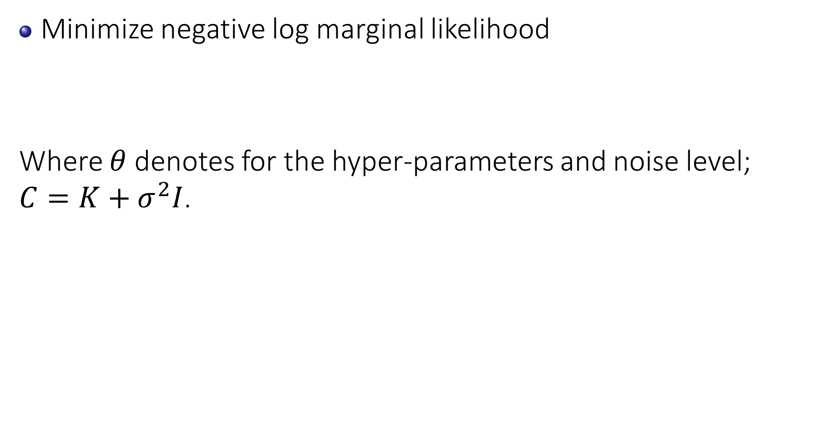
Treatment for GP Hyper-parameters
Minimize negative log marginal likelihood
Where $θ$ denotes for the hyper-parameters and noise level; $C=K+σ^{2}I$.

Slide 54
Treatment for GP Hyper-parameters
MCMC for GP Hyper-parameters
Slice sampling of hyper-parameters
Integrated Acquisition Function

Slide 55
Outline Part 1: Bayesian Optimization
Bayesian Optimization
Gaussian Processes
Acquisition Functions
Illustration
Upper Confidence Bound (UCB) and Expected Improvement (EI)
Thompson Sampling (TS) and Predictive Entropy Search (PES)
Computational Time
Optimization toolbox for acquisition function.
GP Hyper-parameter Treatments
Applications

Slide 56
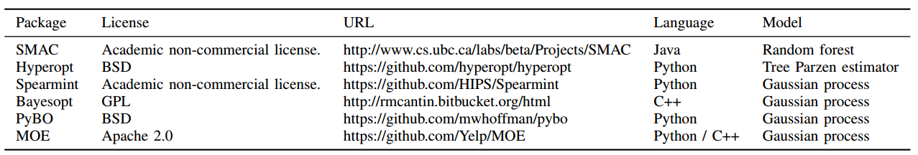
Library for Bayesian Optimization
Shahriari et al 2016

Slide 57
Applications
Robot control design
Alloy design
Heat-treatment design
Machine learning hyper-parameter tuning.
….

Slide 58
Applications – Robot Design
Tuning 8 parameters to maximize the horizontal velocity of bipedal robot [Westervelt et al 2007].

Slide 59
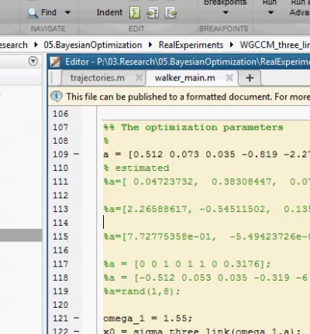
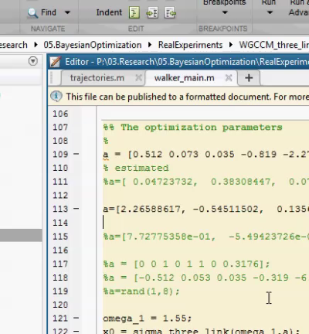
Applications – Robot Design
Before tuning
After tuning with Bayesian optimization

Slide 60
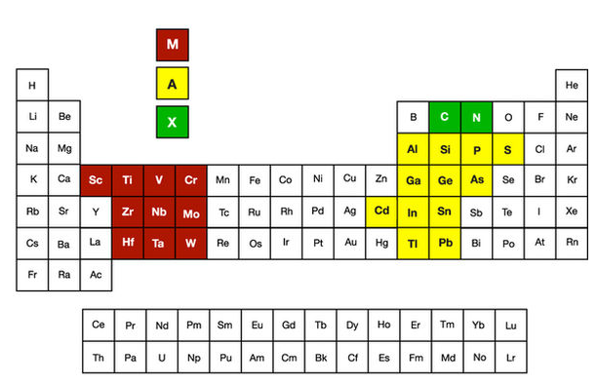
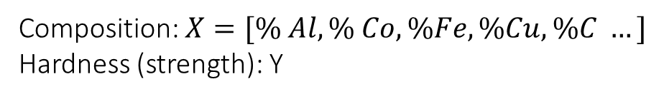
Applications – Alloy Design
Composition: $X=[\% Al, \% Co, \%Fe, \%Cu, \%C …]$
Hardness (strength): Y

Slide 61
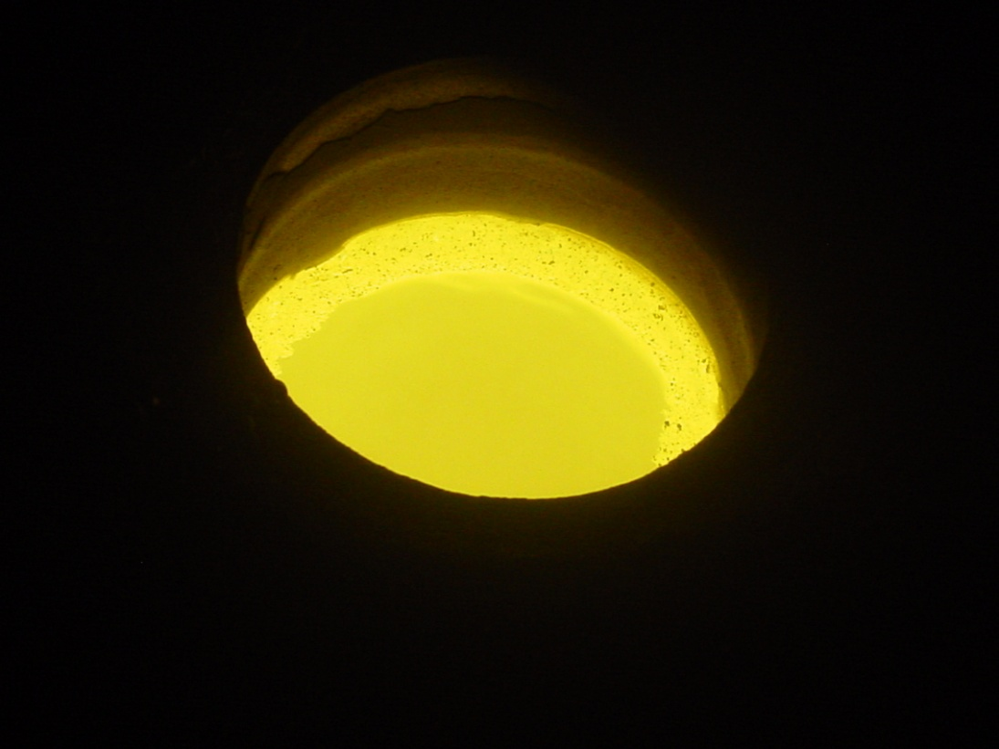
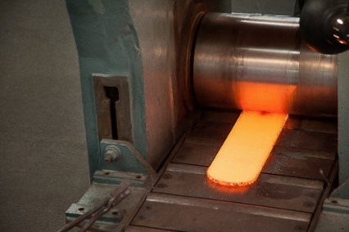
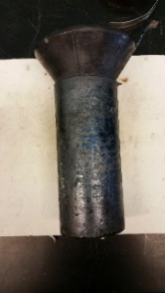
Applications – Alloy Design Process with BO
ThermoCalc Chemistry Estimation
Vacuum Induction Melting
Forging
Heat Treatment
Design Criteria Met?
Bayesian
Optimization
No
Characterization
(XRD, Hardness, etc.)
Yes
Success
Notes:
The prediction is not just an estimate for that point, but also has uncertainty information -- it is a one-dimensional Gaussian distribution (which is the marginal distribution at that point).

Slide 62

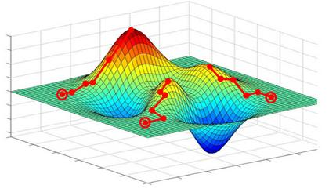
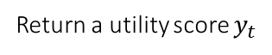
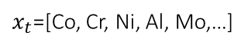
Application: Ni-Alloy Optimization Process
$x_{t}$=[Co, Cr, Ni, Al, Mo,…]
Suggest a composition
Bayesian optimization
Temperatures (Degree C)
750 | 800 | …
Return a utility score $y_{t}$
Phases
* DO24
* Sigma
*…etc
Phases
* DO24
* Sigma
*…etc
S. Rana, C. Li, S. Gupta, V. Nguyen, & S. Venkatesh. High dimensional bayesian optimization with elastic gaussian process. In ICML 2017 (pp. 2883-2891).
Notes:
Calphad: Computer Coupling of Phase Diagrams and Thermochemistry

Slide 63
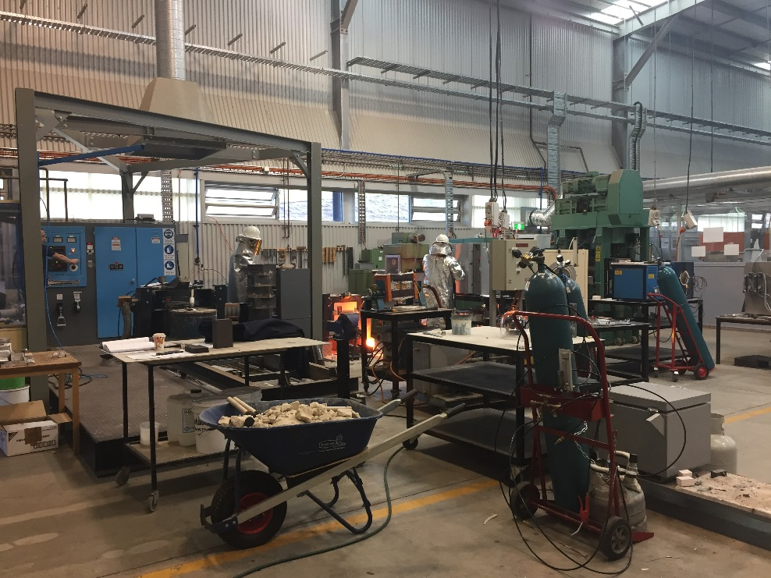

Applications – Alloy Design Testing
Costly alloy testing to evaluate each suggested point sequentially.
IFM
Notes:
The prediction is not just an estimate for that point, but also has uncertainty information -- it is a one-dimensional Gaussian distribution (which is the marginal distribution at that point).

Slide 64
Bayesian Optimization of Superalloy Designs
J Licavoli, P Sanders, S Rana, S Gupta, V Nguyen, S Venkatesh. Bayesian Optimization of Superalloy Designs. 4th World Congress on Integrated Computational Materials Engineering (ICME 2017)

Slide 65
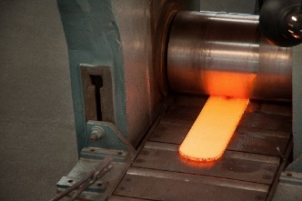

Applications – Alloy Design Process with BO
ThermoCalc Chemistry Estimation
Vacuum Induction Melting
Forging
Heat Treatment
Design Criteria Met?
Bayesian
Optimization
No
Characterization
(XRD, Hardness, etc.)
Yes
Success
Notes:
The prediction is not just an estimate for that point, but also has uncertainty information -- it is a one-dimensional Gaussian distribution (which is the marginal distribution at that point).

Slide 66
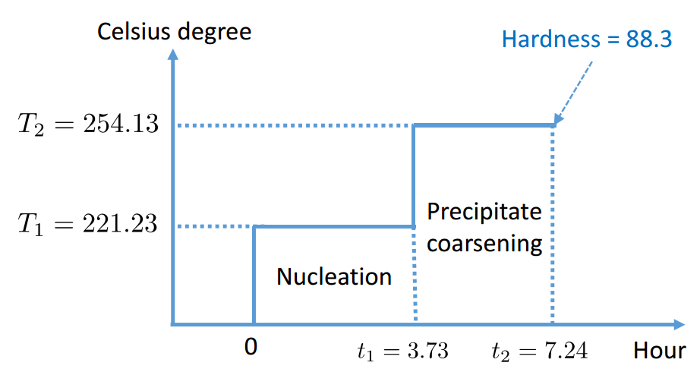
Applications – Heat-treatment Design
TD Nguyen, S Gupta, S Rana, V Nguyen, S Venkatesh, KJ Deane & P Sanders. “Cascade Bayesian Optimization”. In Australasian Joint Conference on Artificial Intelligence (pp. 268-280). 2016. Springer.
V Nguyen, R Santu, G Sunil, L Cheng, and S Venkatesh.
"Budgeted batch Bayesian optimization." In ICDM 2016, pp. 1107-1112.

Slide 67
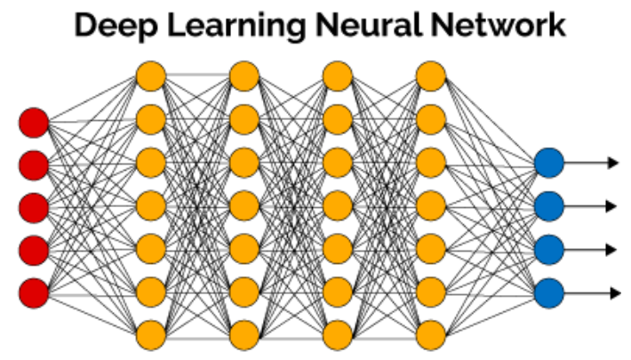
Applications – Tuning Deep Learning
Deep learning offers breakthrough in image recognition, speed recognition, self-driving cars.
Hyper-parameters include number of layers, weight regularization, layer size, which nonlinearity, mini-batch size, learning rate, stopping conditions.
Photo from hackernoon.com

Slide 68
Bayesian Optimization for Tuning Deep Learning
Deep learning offers breakthrough in image recognition, speed recognition and self-driving cars.
The DL performance critically depends on the hyperparameters.
Hyperparameters include
#layers,
#node per layer,
mini-batch size,
learning rate…
Photo from hackernoon.com

Slide 69
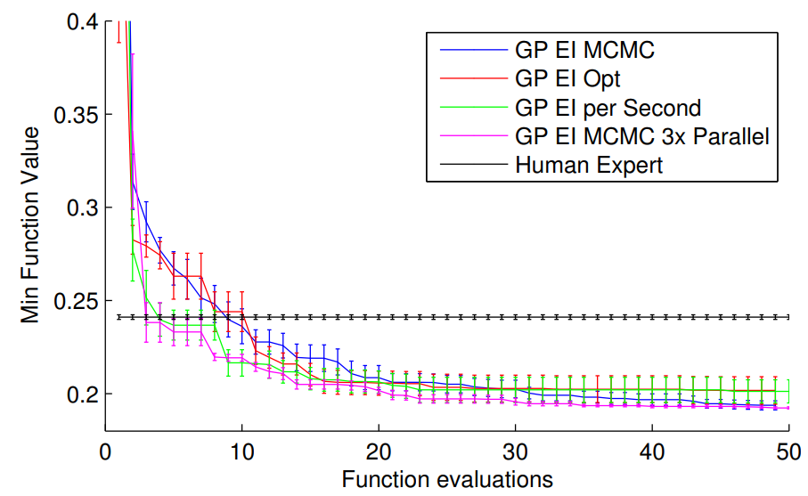



Bayesian Optimization for Tuning Deep Learning
DL hyperparameter
$x=[x_{1},…,x_{D}]$
Accuracy
$$y=f(x)$$
Bayes Opt is better than human expert tuning for deep learning.
$$f(x)$$
Snoek, J. et al. Practical Bayesian optimization of machine learning algorithms. NIPS 2012.

Slide 70

BO for Tuning Deep Reinforcement Learning
Win-rate from
50% to 66%

Slide 71
Short Summary
Bayesian optimization is essential for hyper-parameters tuning of the black-box functions (e.g., machine learning algorithm and experimental design).
Bayesian optimization has both theoretical guarantee and empirical success that it performs better than random search and grid search (especially for high dimensions).
Bayesian optimization is an active research direction.

Slide 72

Short Summary
Bayesian optimization is an active research direction.
Google scholar 74.000 results since 2013.

Slide 73

Question and Answer

Slide 74
Reference
V. Nguyen, S. Gupta, S. Rana, C. Li, S. Venkatesh. Regret for Expected Improvement over the Best-Observed Value and Stopping Condition. In Proceedings of The 9th Asian Conference on Machine Learning, (ACML), 2017.
Hernandez-Lobato, J. M., Hoffman, M. W., & Ghahramani, Z. Predictive entropy search for efficient global optimization of black-box functions. In Advances in Neural Information Processing Systems (NIPS), pp. 918–926, 2014.
Hennig, P., & Schuler, C. J. Entropy search for information-efficient global optimization. Journal of Machine Learning Research, 13, 1809–1837, 2012.
T. D. Nguyen, S. K. Gupta, S. Rana, V. Nguyen, S. Venkatesh, K. Deane, P. Sanders. Cascade Bayesian Optimization. In Proceedings The 29th Australasian Joint Conference on Artificial Intelligence, (AI), pp 268-280, 2016.
Rasmussen, C. E. Gaussian processes for machine learning, 2006.
Mockus, J., Tiesis, V., & Zilinskas, A. The application of bayesian methods for seeking the extremum. Towards global optimization, 2(117-129), 2, 1978.
Snoek, J., Larochelle, H., & Adams, R. P. Practical bayesian optimization of machine learning algorithms. In Advances in neural information processing systems (pp. 2951-2959), 2012.
V. Nguyen, M. A. Osborne. Knowing The What But Not The Where in Bayesian Optimization. International Conference on Machine Learning (ICML), 2020.

Slide 75
Reference
T. Le, K. Nguyen, V. Nguyen, T. D. Nguyen, D. Phung. GoGP: Fast Online Regression with Gaussian Processes. In Proceedings of the IEEE International Conference on Data Mining, (ICDM), 2017.
Jones, D. R., Perttunen, C. D., & Stuckman, B. E. Lipschitzian optimization without the lipschitz constant. Journal of Optimization Theory and Applications, 79(1), 157–181, 1993.
Kushner, H. J. A new method of locating the maximum point of an arbitrary multipeak curve in the presence of noise. Journal of Basic Engineering, 86(1), 97-106, 1964.
Rahimi, A. and Recht, B., Random features for large-scale kernel machines. In Advances in neural information processing systems, pp. 1177-1184, 2008.
Li, C., de Celis Leal, D.R., Rana, S., Gupta, S., Sutti, A., Greenhill, S., Slezak, T., Height, M. and Venkatesh, S., 2017. Rapid Bayesian optimisation for synthesis of short polymer fiber materials. Scientific reports, 7(1), p.5683.
F. Hutter, H. H. Hoos, and K. Leyton-Brown, ‘‘Sequential model-based optimization for general algorithm configuration,’’ Learning and Intelligent Optimization, Berlin, Germany: Springer-Verlag, 2011, pp. 507–523.
J. Snoek et al., ‘‘Scalable Bayesian optimization using deep neural networks,’’ in ICML 2015, pp. 2171–2180.
J. Parker-Holder, V. Nguyen, SJ. Roberts. Provably Efficient Online Hyperparameter Optimization with Population-Based Bandits. AutoML workshop at (ICML), 2020.

